Slide 1

Dot Ai
Investor Presentation
March 2025
1
Notes:
(Charlie Owns this Slide)

Slide 2

Disclaimer: About this Presentation
This confidential investor presentation (this “Presentation”) is being provided to select accredited investors in connection with a proposed business combination (the “Business Combination”) between ShoulderUp Technology Acquisition Corporation (“SUAC”) and SEE ID, Inc. (the “Company”). The information contained herein does not purport to be all-inclusive and none of SUAC, the Company or their respective affiliates, or any of their control persons, officers, directors, employees or representatives makes any representation or warranty, express or implied, as to the accuracy, completeness or reliability of the information contained in this Presentation. This Presentation does not constitute (i) a solicitation of a proxy, consent or authorization with respect to any securities or in respect of the proposed Business Combination or (ii) an offer to sell, a solicitation of an offer to buy, or a recommendation to purchase any security of SUAC, the Company, the combined company, or any of their respective affiliates. No such offering of securities shall be made except by means of a prospectus meeting the requirements of Section 10 of the Securities Act of 1933, as amended, or an exemption therefrom. You should not construe the contents of this Presentation as legal, tax, accounting or investment advice or a recommendation. You should consult your own counsel and tax and financial advisors as to legal and related matters concerning the matters described herein, and, by accepting this Presentation, you confirm that you are not relying upon the information contained herein to make any decision.
The distribution of this Presentation is restricted to intended recipients only. The recipient acknowledges that (a) it is aware that the United States securities laws prohibit any person who has material non-public information concerning a company from purchasing or selling securities of such company or from communicating such information to any other person under circumstances in which it is reasonably foreseeable that such person is likely to purchase or sell such securities, and (b) recipient will neither use, nor cause any third party to use, this Presentation or any information contained herein in contravention of applicable securities laws.
This Presentation and the information contained herein constitutes confidential information, is intended for the recipient hereof only and is provided to the recipient on the condition that the recipient agrees that it will hold such information in strict confidence and not reproduce, disclose, forward or distribute such information in whole or in part without the prior written consent of SUAC and the Company. Upon request, the recipient will promptly return all materials, including the Presentation, received from either SUAC or the Company without retaining any copies thereof.
SUAC and the Company have executed a Business Combination Agreement (“BCA”) to accomplish the Business Combination. The proposed Business Combination is subject to, among other things, the approval by SUAC’s stockholders and satisfaction of the closing conditions stated in the BCA. Accordingly, there can be no assurance that the proposed Business Combination will be consummated.
3

Slide 3
Disclaimer: Forward Looking Statements
Certain statements, estimates, targets and projections in this Presentation may be considered forward-looking statements. Forward-looking statements generally relate to future events or SUAC’s or the Company’s future financial or operating performance. In some cases, you can identify forward-looking statements by terminology such as “may,” “should,” “expect,” “intend,” “will,” “estimate,” “anticipate,” “believe,” “predict,” “potential,” or “continue,” or the negatives of these terms or variations of them or similar terminology, but the absence of these words does not mean that a statement is not forward-looking. Such forward-looking statements are subject to risks, uncertainties, and other factors which could cause actual results to differ materially from those expressed or implied by such forward looking statements. Forward-looking statements in this Presentation may include, for example, statements about:
• the ability to complete the Business Combination;
• the benefits of the Business Combination;
• the future financial performance following the Business Combination; and
• commercialization, growth, and expansion plans and opportunities.
These forward-looking statements are based on estimates and assumptions that, while considered reasonable by SUAC and the Company, are inherently uncertain. There can be no assurance that future developments affecting SUAC and the Company will be those that have been anticipated. These forward-looking statements involve a number of risks, uncertainties (some of which are beyond SUAC’s or the Company’s control) or other assumptions that may cause actual results or performance to be materially different from those expressed or implied by these forward-looking statements. These risks and uncertainties include, but are not limited to:
• the occurrence of any event, change or other circumstances that could give rise to the termination of the definitive agreements governing the Business Combination;
• the outcome of any legal proceedings that may be instituted against SUAC, the combined company or others following the announcement of the Business Combination and any definitive agreements with respect thereto;
• the inability to complete the Business Combination due to the failure to obtain approval of the stockholders of SUAC, to obtain financing to complete the Business Combination or to satisfy other conditions to closing;
• changes to the proposed structure of the Business Combination that may be required or appropriate as a result of applicable laws or regulations or as a condition to obtaining regulatory approval of the Business Combination;
4

Slide 4
Disclaimer: Forward Looking Statements
(continued from previous page)
• the ability to meet stock exchange listing standards following the consummation of the Business Combination;
• the risk that the Business Combination disrupts current plans and operations of the Company as a result of the announcement and consummation of the Business Combination;
• the ability of the combined company to recognize the anticipated benefits of the Business Combination, which may be affected by, among other things, competition, the ability of the combined company to grow and manage growth profitably, maintain relationships with customers and suppliers and retain its management and key employees;
• costs related to the Business Combination;
• changes in applicable laws or regulations;
• the possibility that the Company or the combined company may be adversely affected by other economic, business, or competitive factors;
• inaccuracy of estimates of expenses and profitability;
• the ability to raise necessary financing in the future;
• success in retaining or recruiting, or changes required in, officers, key employees or directors following the Business Combination;
• Limitations on the liquidity and trading of the securities of the combined company;
• the expenses and requirements of being a public company, including compliance with the SEC’s requirements regarding internal controls over financial reporting;
• litigation and the ability to adequately protect the Company’s intellectual property rights; and
• other factors relating to the business, operations and financial performance detailed under the section titled “Risk Factors” in the proxy statement/prospectus included in the Registration Statement on Form S-4 filed by SUAC with the SEC. Should one or more of these risks or uncertainties materialize, or should any of our assumptions prove incorrect, actual results may vary in material respects from those projected in forward-looking statements. Nothing in this Presentation should be regarded as a representation by any person that the forward-looking statements set forth herein will be achieved or that any of the contemplated results of such forward-looking statements will be achieved. You should not place undue reliance on forward-looking statements,
which speak only as of the date they are made. Neither SUAC nor the Company undertakes any duty to update these forward-looking
statements.
5

Slide 5
Disclaimer: Use of Projections
This Presentation contains financial forecasts for the Company with respect to certain financial results for the Company. Neither SUAC’s nor the Company’s independent auditors have audited, studied, reviewed, compiled or performed any procedures with respect to the projections for the purpose of their inclusion in this Presentation, and accordingly, they did not express an opinion or provide any other form of assurance with respect thereto for the purpose of this Presentation. These projections are forward-looking statements and should not be relied upon as being necessarily indicative of future results. In this Presentation, certain of the above-mentioned projected information has been provided for purposes of providing comparisons with historical data. The assumptions and estimates underlying the prospective financial information are inherently uncertain and are subject to a wide variety of significant business, economic and competitive risks and uncertainties that could cause actual results to differ materially from those contained in the prospective financial information. Accordingly, there can be no assurance that the prospective results are indicative of the future performance of the Company or that actual results will not differ materially from those present in the prospective financial information. Inclusion of the prospective financial information in this Presentation should not be regarded as a representation by any person that the results contained in the prospective financial information will be achieved.
6

Slide 6
Disclaimer: Financial Information
The historical financial information and data contained in this Presentation has not been audited in accordance with the standards of the Public Company Accounting Oversight Board and does not conform to Regulation S-X. Such information and data may not be included in, may be adjusted in or may be presented differently in the registration statement to be filed by SUAC relating to the Business Combination and the proxy statement/prospectus contained therein. This Presentation also includes certain financial measures not presented in accordance with generally accepted accounting principles (“GAAP”) including Adjusted EBITDA and certain ratios and other metrics derived therefrom. The Company defines Adjusted EBITDA as net income (loss) before interest expense, tax expense, depreciation and amortization, stock-based compensation expense and other one-time or non-recurring expenses, such as executive recruiting fees, severance, 3rd party consulting fees, and transaction-related fees, among others, that the Company does not believe are recurring in nature or necessary for the ongoing operations of the business. Non-GAAP financial measures are not measures of financial performance in accordance with GAAP and may exclude items that are significant in understanding and assessing the Company's financial results. Therefore, these measures should not be considered in isolation or as an alternative to net income, cash flows from operations or other measures of profitability, liquidity or performance under GAAP. You should be aware that the Company's presentation of these measures may not be comparable to similarly-titled measures used by other companies. The Company believes these non-GAAP measures of financial results provide useful information to management and investors regarding certain financial and business trends relating to the Company's financial condition and results of operations. The Company believes that the use of non-GAAP financial measures provides an additional tool for investors to use in evaluating ongoing operating results and trends in comparing the Company’s financial measures with other similar companies, many of which present similar non-GAAP financial measures to investors. These non-GAAP financial measures are subject to inherent limitations as they reflect the exercise of judgments by management about which expense and income are excluded or included in determining these non-GAAP financial measures. This Presentation also includes certain projections of non-GAAP financial measures. Due to the high variability and difficulty in making accurate forecasts and projections of some of the information excluded from these projected measures, together with some of the excluded information not being ascertainable or accessible, the Company in unable to quantify certain amounts that would be required to be included in the most directly comparable GAAP financial measures without unreasonable effort. Consequently, no disclosure of estimated comparable GAAP measures is included and no reconciliation of the forward-looking non-GAAP financial measures is included.
7

Slide 7
Other Disclaimers
Industry and Market Data
In this Presentation, the Company relies on and refers to certain information and statistics obtained from third-party sources which it believes to be reliable. Neither SUAC nor the Company has independently verified the accuracy or completeness of any such third-party information.
Trademarks and Copyright
This Presentation may contain trademarks, service marks, trade names and copyrights of other companies, which are the property of their respective owners. Solely for convenience, some of the trademarks, service marks, trade names and copyrights referred to in this Presentation may be listed without the TM, SM, © or ® symbols, but SUAC and the Company will assert, to the fullest extent under applicable law, the rights of the applicable owners, if any, to these trademarks, service marks, trade names and copyrights.
8

Slide 8
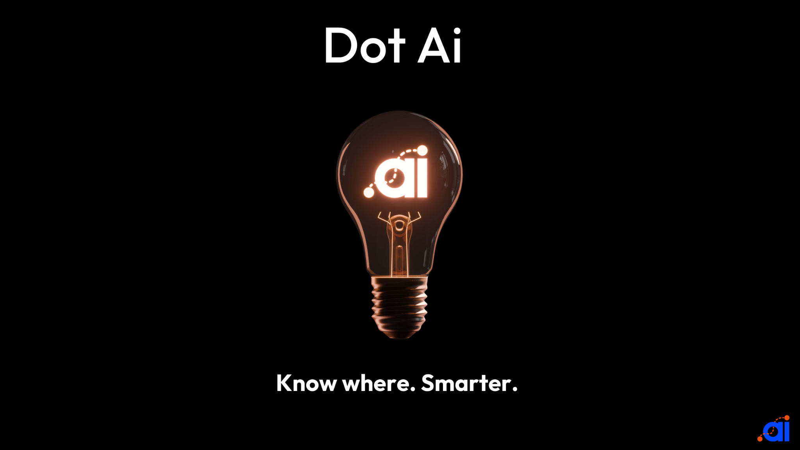
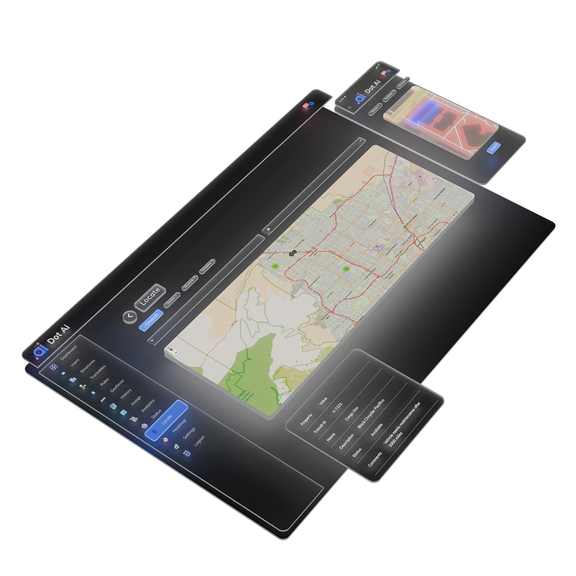
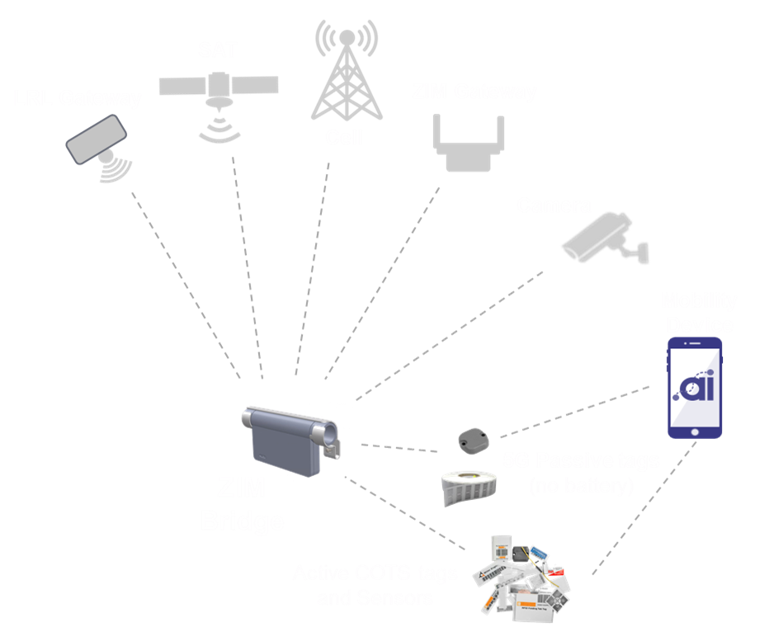
SAAS provider of disruptive AI asset tracking and logistics technology
AI driven intelligence
IoT Data Collection
Know Where. Smarter.

Slide 9
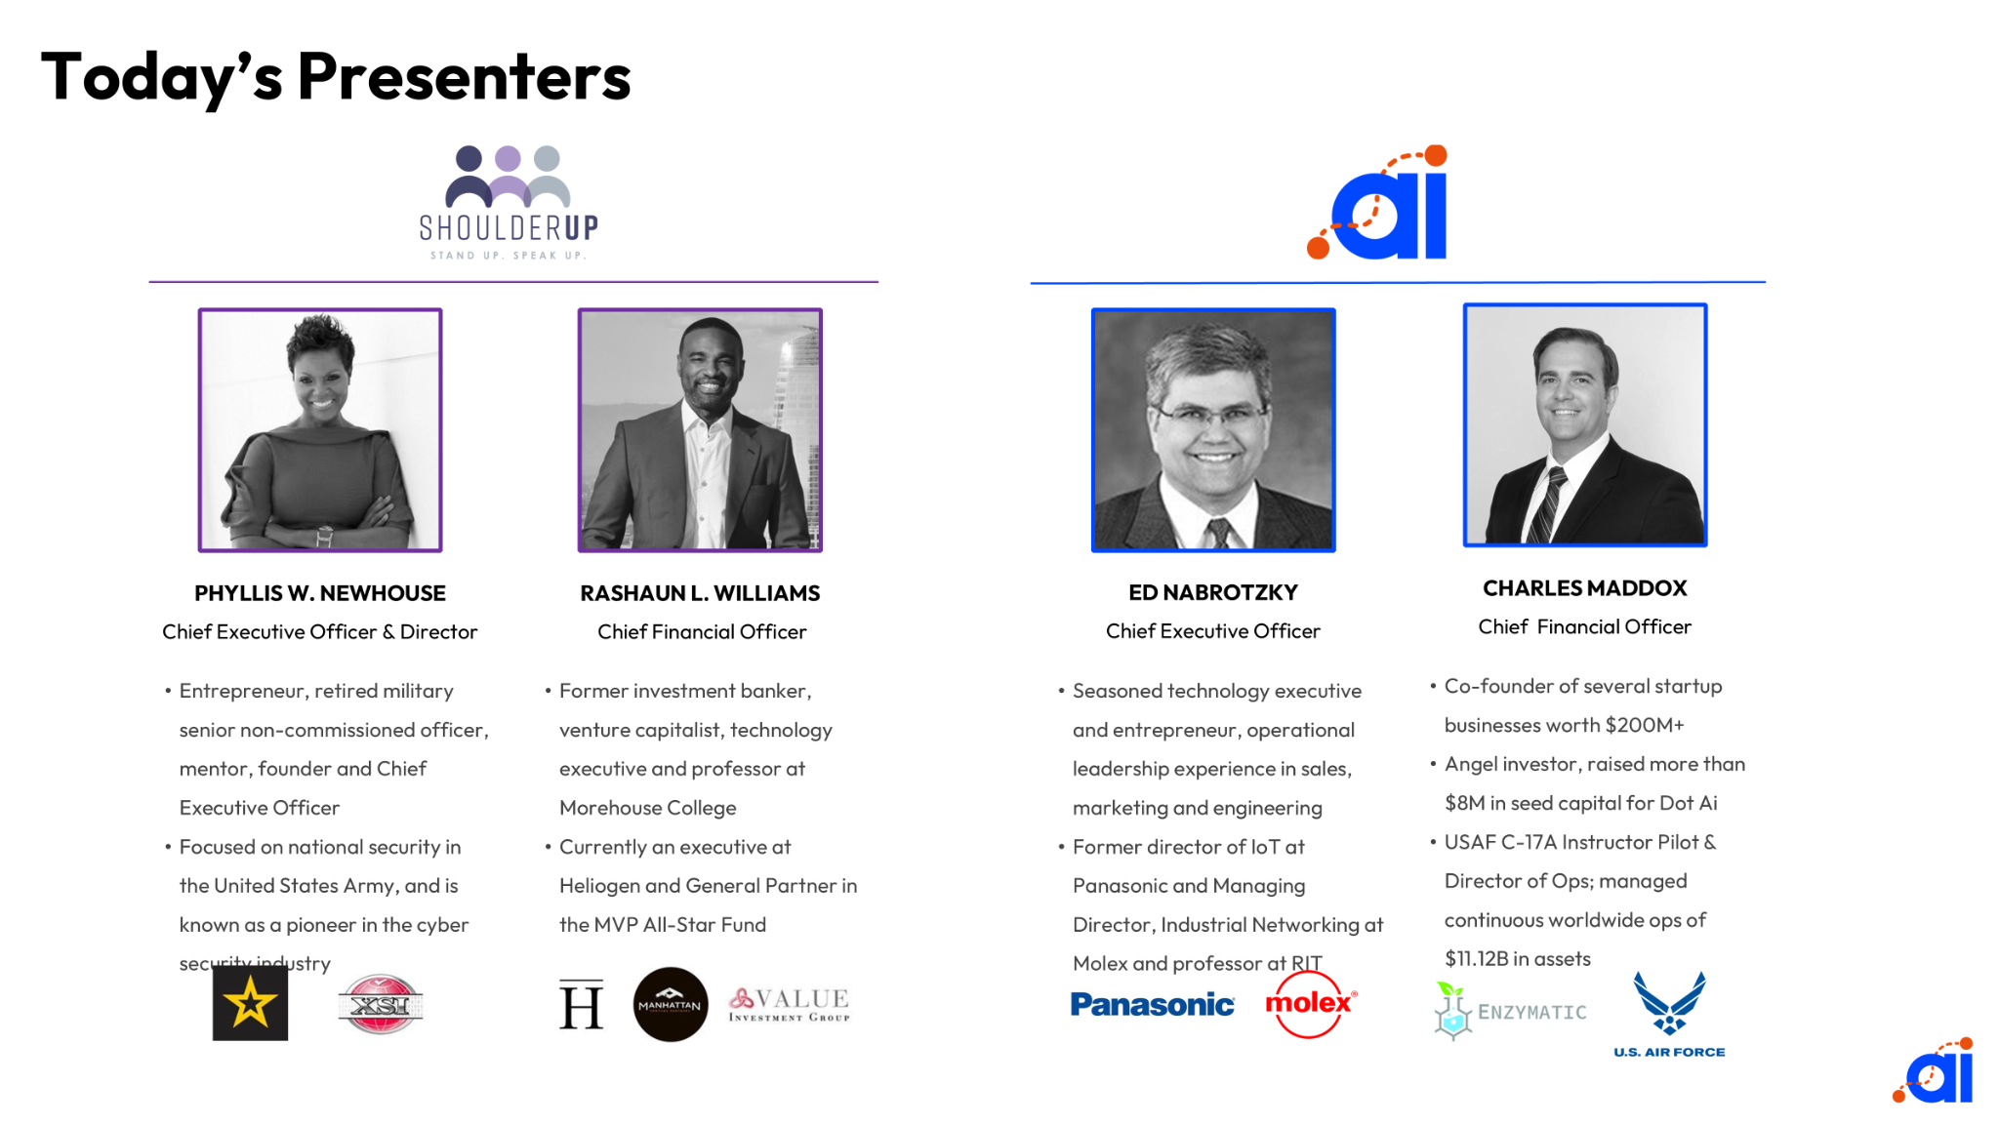
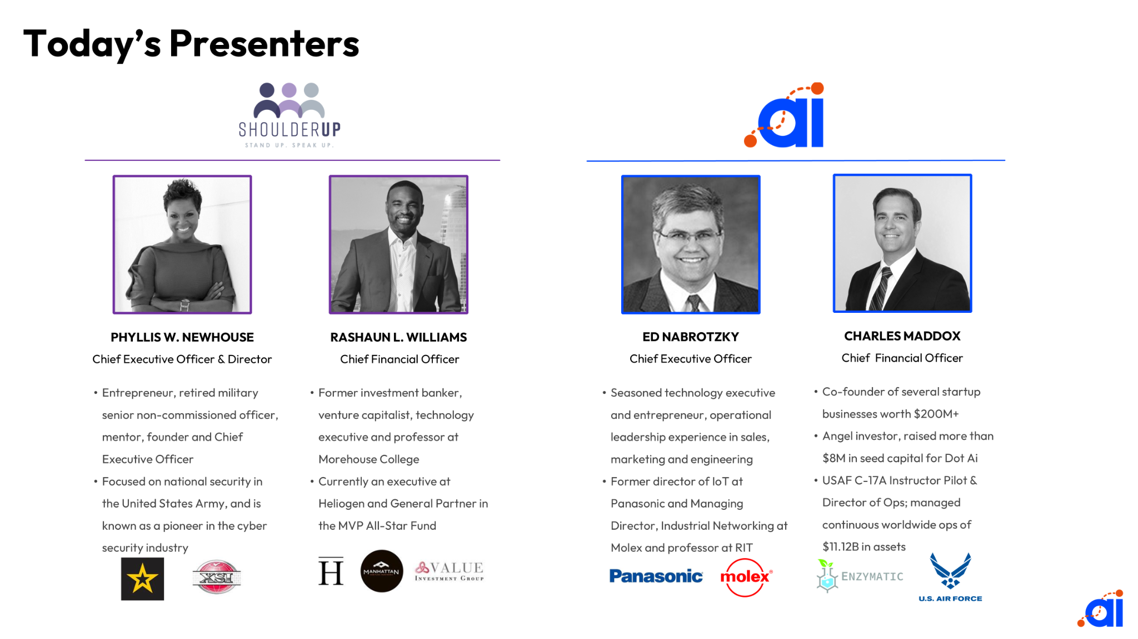

  Overview
    Disclaimers
    Presenters
    Transaction Overview
  Introduction
    Dot Ai Introduction
      Solution
      Target Market
      Sales Methodology
      Investment Highlights
  Product & Technology
    Product & Technology
      Product Suite
      How it Works
    Client Testimonials
  Organizational Detail
  Financial Information
  Appendix
Introduction
Know where. Smarter.
Asset Intelligence for Digital Supply Chain Solutions
2
Notes:
2

Slide 10

Investment Highlights
1
Disruptive next-gen asset management & logistics tech applied to public and private sectors.
2
Patented technology combines asset & workflow management in real-time, providing actionable insights driven by AI.
3
Early traction with enterprise customer Wurth, potential for $1B in sales over the next 5 years
Other customers progressing including Rooms 2 Go, Wagner Warehousing, and U.S. Air Force.
4
Poised for significant growth starting from $2.2M in revenue and $4.2M in bookings for 2024.
5
Organic growth underlined by Capex-light business model.
6
Management Team and Board with strong track record of technical and operational execution.
12

Slide 11
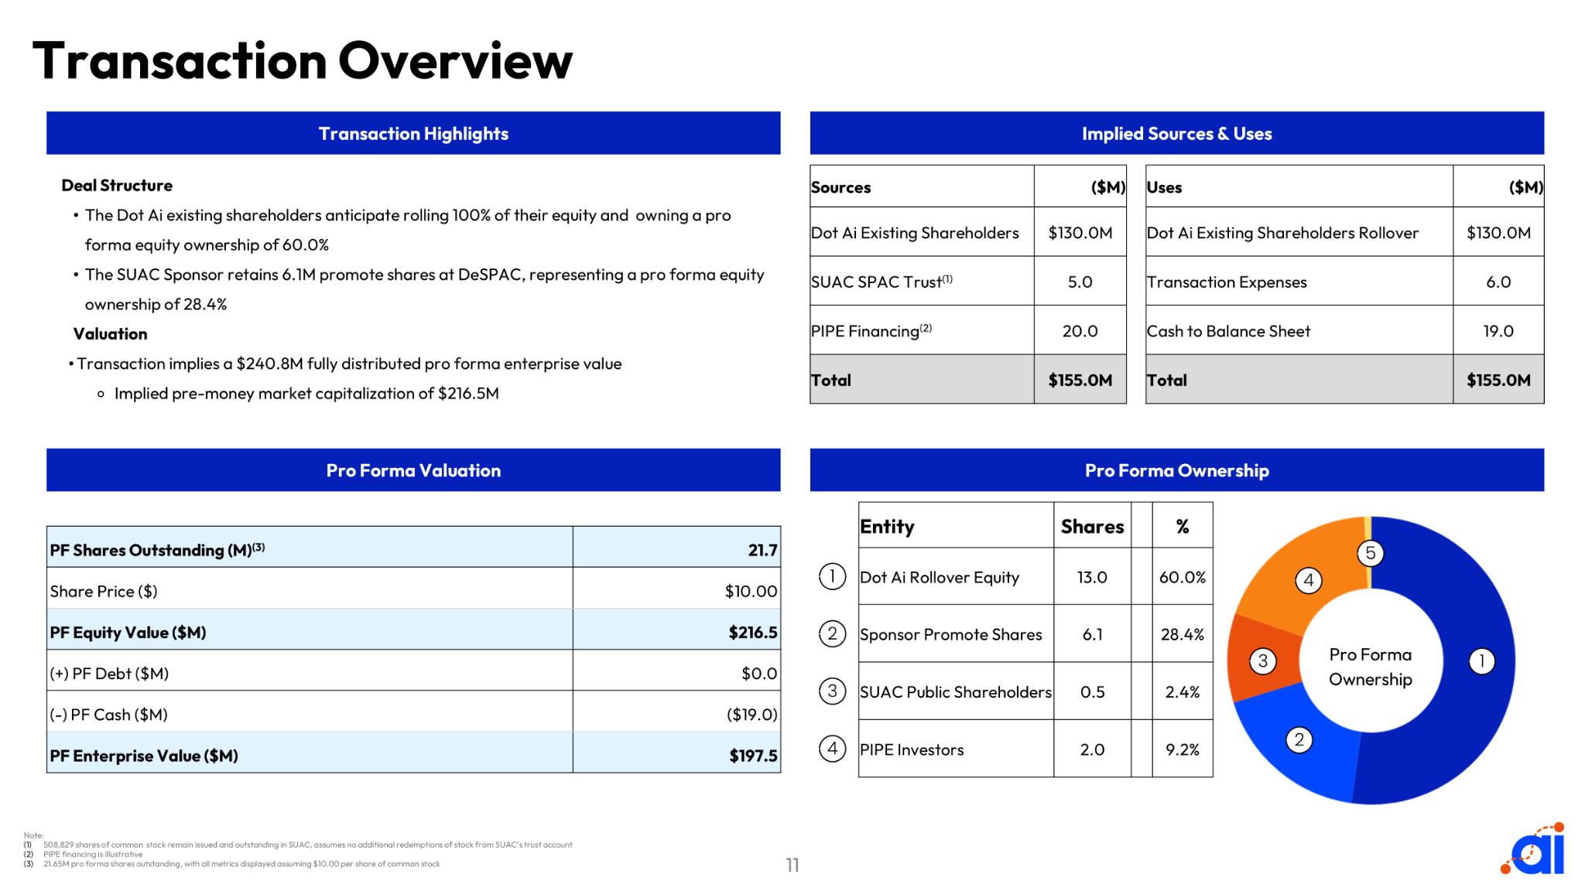




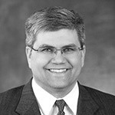













Today’s Presenters
PHYLLIS W. NEWHOUSE
Chief Executive Officer & Director
RASHAUN L. WILLIAMS
Chief Financial Officer
ED NABROTZKY
Chief Executive Officer
CHARLES MADDOX
Chief Financial Officer
BOB RENY
Chief Revenue Officer
  Entrepreneur, retired military senior non-commissioned officer, mentor, founder and Chief Executive Officer
  Focused on national security in the United States Army, and is known as a pioneer in the cyber security industry
  Former investment banker, venture capitalist, technology executive and professor at Morehouse College
  Currently an executive at Heliogen and General Partner in the MVP All-Star Fund
  Seasoned technology executive and entrepreneur, operational leadership experience in sales, marketing and engineering
  Former director of IoT at Panasonic and Managing Director, Industrial Networking at Molex
  Co-founder of several startup businesses worth $300M+
  Angel investor, raised more than $8M in seed capital for Dot Ai
  USAF C-17 pilot & Director of Ops; managed continuous worldwide ops of $11.12B in assets
  Former Executive in sales and sales engineering with Forescout and Exabeam
  20+ years of experience in information technology value selling. Including: building teams, training, managing, and closing global 1000 customers
10

Slide 12



The Problem with Having Things…
Visibility
Actions
  Who has my Things?
  What is the state of my Things?
  Where are my Things?
  When will my Things get there?
  Why are my Things not there?
  How many Things do I have?
$3.5T Annually
  Put Away my Things.
  Pick the Thing I need.
  Pack some Things to ship.
  Move my Things to another place.
  Measure my Things.
  Count my Things.
  Secure my Things.
… legacy management solutions are slow and inaccurate
14

Slide 13



The Disruptive Change
Industrial Logistics and Asset Management markets are in transition.
AI
Artificial Intelligence
IoT
Internet of Things
Cloud Computing
New technologies create real-time, accurate and dynamic smart systems that will completely revolutionize the way we manage assets
15
Notes:
15

Slide 14

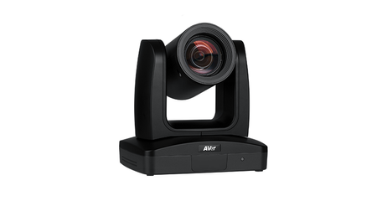

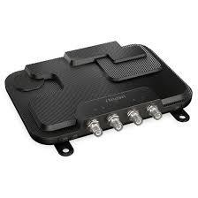
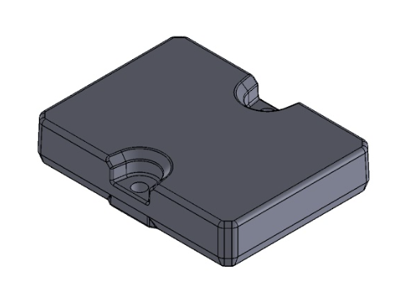
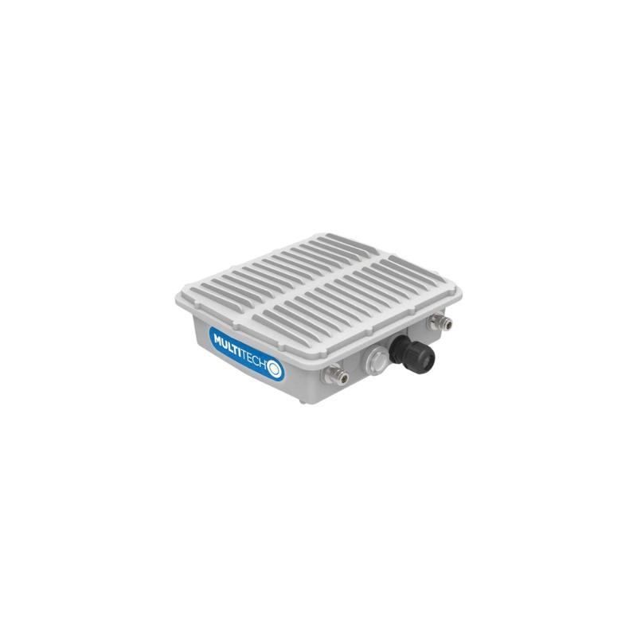
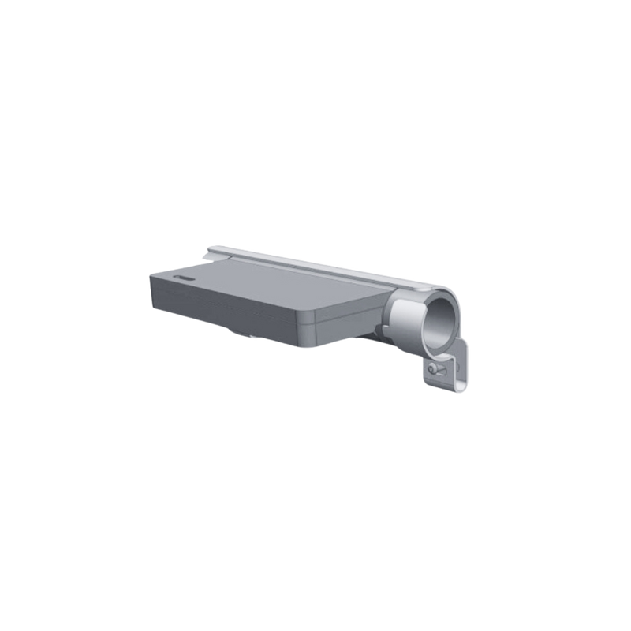
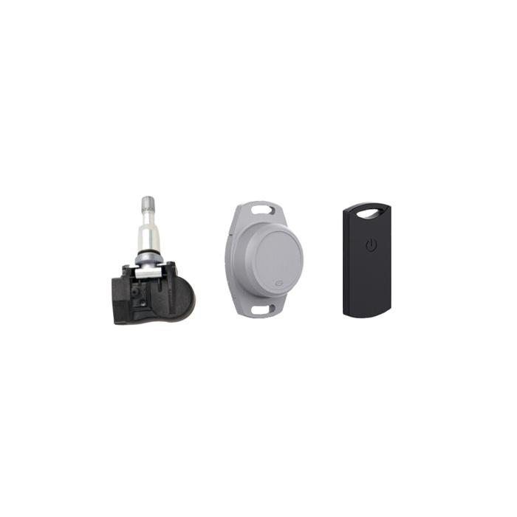
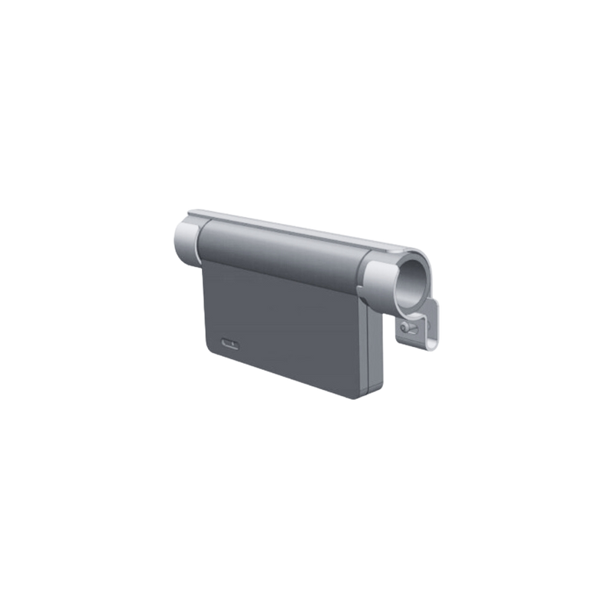
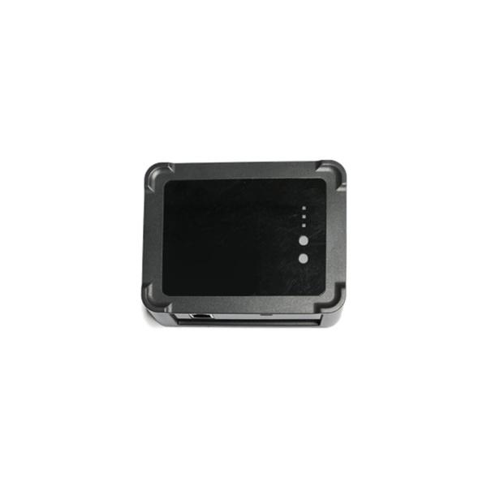
Product Suite
SAAS
CLOUD SOFTWARE
INDUSTRIAL CAMERA
Patents Granted and Pending
PASSIVE LABEL
RFID READER
PASSIVE INDUSTRIAL TAG
Patented
MOBILE BRIDGE
Patent Pending
FIXED GATEWAY (LRL)
MOBILE GATEWAY
Patent Pending
COTS TAGS & SENSORS
FIXED GATEWAY (ZIM)
26
Notes:
26

Slide 15







Our Target Markets
Industrial Logistics and Asset Management
Solution Areas
Market Size
Material Handling & Logistics
Total addressable verticals, applications and industries yet to adopt
Yard & Warehouse Management
TAM
$3.5T
Equipment Tracking & Management
SAM
$32B
Global Logistics & Supply Chain Software Market Size
Access Control & Security
Service & Care Enablement
SOM
$3.6B
Traceability & Authentication
Direct Competitive Annual Revenue
Applicable Industries
ENTERTAINMENT | RETAIL | MANUFACTURING | LOGISTICS | MINING & ENERGY | CONSTRUCTION | TRANSPORTATION | FOOD & BEVERAGE | HEALTH CARE | FACILITIES MANAGEMENT | PHARMACEUTICALS | AGRICULTURE | MILITARY & GOVERNMENT
18
Notes:
The global logistics software market size was valued at USD 14.83 billion in 2022. It is estimated to reach USD 33.17 billion by 2031, growing at a CAGR of 9.36% during the forecast period (2023–2031). Innovative technologies like AI, IoT, and Blockchain are gaining popularity across different industry verticals. – Straits Research – Logistics Software Market
According to Emergen Research, the global Radio Frequency Identification (RFID) market size was USD 15.77 Billion in 2022 and is expected to register a rapid revenue CAGR of 14.7% to during the forecast period, growing to more than $45B by 2030.
Samsara revenue for the twelve months ending April 30, 2024 was $1.014B, which they claimed represented 9.66% of the “IoT platform category” ($10.5B category size).

Slide 16


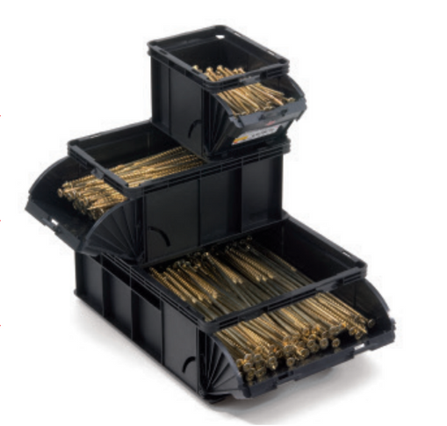
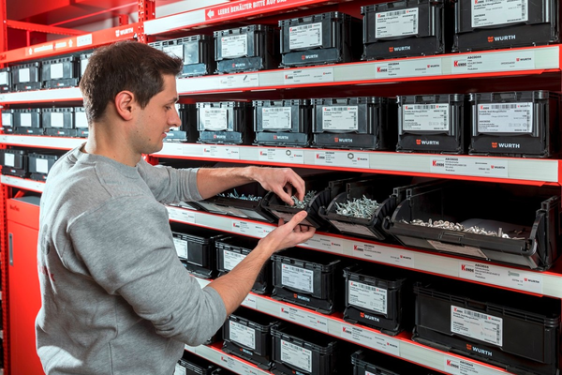
Proven Success Within Critical Enterprises
Customer Spotlight
Wurth Industries: Real-time inventory awareness and intervention ensures customers never run out of material and eliminates costly expediting.
Our demonstrated ability to provide smart software tools and work on-metal in a dense industrial environment has created a global opportunity with a industry leader in fasteners.
8-K Filed on November 14, 2024
Exclusive Partnership Announced
intent for deployment of at least $175M over 5 years
includes initial $2M payment
20
Notes:
20

Slide 17
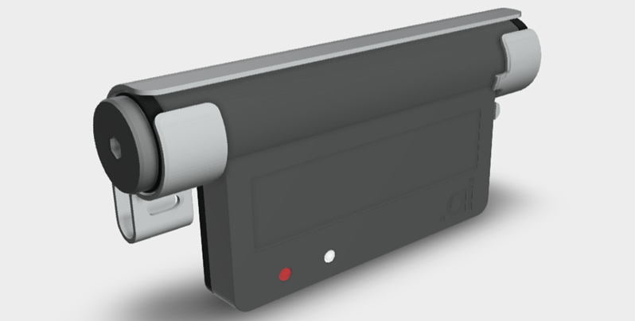
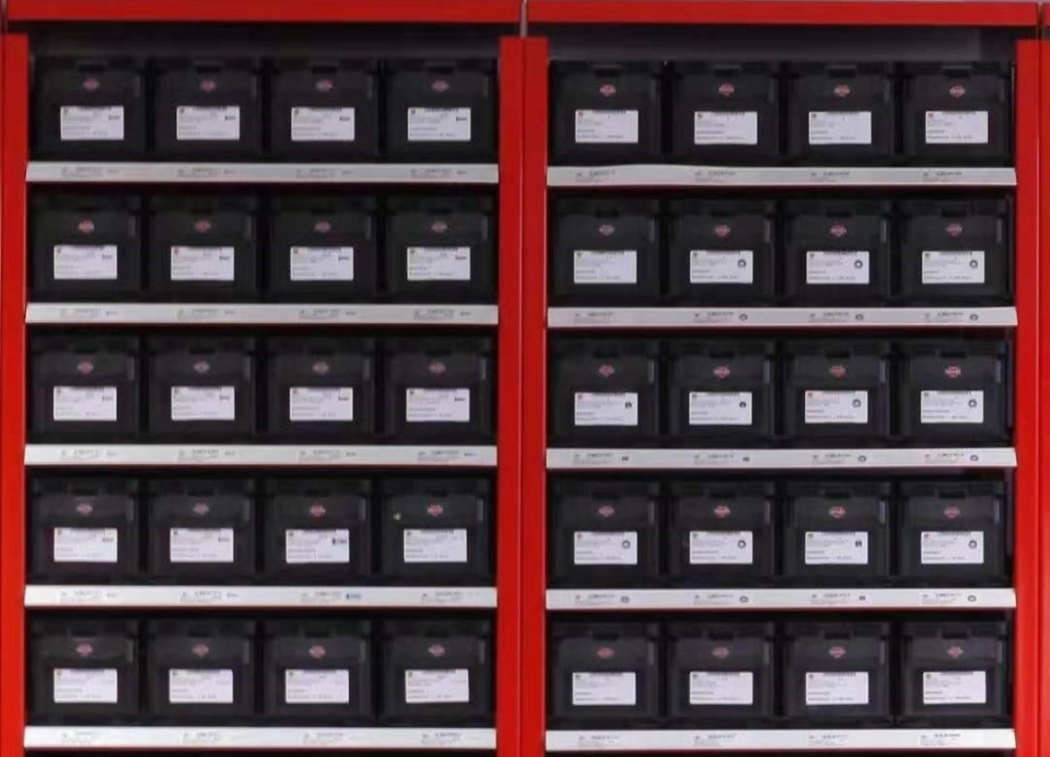

Customer Opportunity Profiling
SAAS subscription
$237,600 / year / location
x 600 locations
= $142,560,000 ARR
44,000 Potential adoption entities at this customer
200 Early Adopters have 600 locations total
= $1,009,200,000 over 5 years
3 Bridges @$122
$4 / month SAAS charge
600 locations x $494,000
= $296,400,000
Hardware Cost
40 Tags @$3.20
$0.15 / month SAAS charge
1000 racks @ $494
= $494,000 / location

Slide 18











Competitive Comparison Chart
BLE RFID
Use of COTS devices
LRL (Long-Range Locating)
Outdoor Tracking
PWA (Progressive Web App)
AI Camera Input
AI Powered Workflows
Vision System Overlays
Battery Powered Bridges
Easy install and scale (mesh)
Passive BLE Tags
19

Slide 19

Uses of Cash
$8M - Enterprise capability
  expansion of functional execution and geographic coverage
  we must scale rapidly to meet the expectations of large customers
$5M - Manufacturing capacity expansion (facility and equipment)
  need for a new facility, 8 new lines and an automated assembly to meet demand
$2M - Compliance and Governance
  Requirements for public entity, cybersecurity
$1.5M - Research & Development
  We need to add scientists in AI, RF/Antenna and Chip Design
  Our leadership will only be sustained with ongoing investment in our core technologies
$1.5M Cash Flow to fuel fulfillment of rapid growth curve
$25M
$7M in deal costs

Slide 20
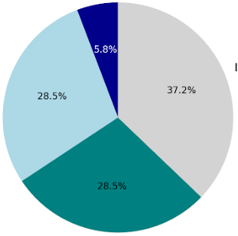

Financial Projections
Growth Forecast
FY2025
(in USD$‘000) | FY2024 Total | HW 20% | ARR 65% | Services 15% | FY2025 Total
Bookings | 4,225 | 6,000 | 19,500 | 4,500 | 30,000
Billings | 3,479 | 3,600 | 4,800 | 4,000 | 12,400
Revenue | 2,259 | 3,600 | 4,000 | 3,200 | 10,800
Gross Margin | 1,721 | 2,340 | 3,680 | 2,080 | 8,100
Gross Margin % | 76.2% | 65.0% | 92.0% | 65.0% | 75.0%
Server Access Fees
Hardware Costs
Asset Data Fees
(Labels, Tags and Beacons)
Transactional Hardware business run from wholly owned subsidiary
A Dot Ai Company
Device Subscription Fees (Bridges and Cameras)
40
Notes:
(Charlie Owns this Slide)
40

Slide 21









The numbers don’t align with the backup – believe you are using a different EV? Is this an old backup?
Please remove Siemens
And put the orange grouping in the middle
Also, add footnotes / sources
Valuation Benchmarking
Core IoT Comparables
High-Growth Cyber Security
Industrial & Network Automation Solutions
xx.x%
Median
158.2%
15.9%
24.3%
5.3%
Revenue CAGR
(’24-’26)
24.5%
26.0%
26.0%
22.5%
21.7%
7.3%
4.9%
5.7%
5.7%
4.1%
9.2%
17.2%
9.2%
3.6%
15.4%
15.0%
EV/Revenue (2025E)
9.3%
9.1%
3.5%
5.3%
3.0%
3.5%
3.7%
3.7%
0.57%
0.42%
0.67%
EV/Revenue/G(2025E)
0.66%
0.76%
0.71%
0.64%
0.50%
0.60%
0.62%
0.13%
0.42%
0.42%
0.21%
Source: FactSet
Note: Market data as of 6/5/2024
41
Notes:
(Charlie Owns this Slide)
41

Slide 22
Investment Highlights
1
Disruptive next-gen asset management & logistics tech applied to public and private sectors.
2
Patented technology combines asset & workflow management in real-time, providing actionable insights driven by AI.
3
Early traction with enterprise customer Wurth, potential for $1B in sales over the next 5 years
Other customers progressing including Rooms 2 Go, Wagner Warehousing, and U.S. Air Force.
4
Poised for significant growth starting from $2.2M in revenue and $4.2M in bookings for 2024.
5
Organic growth underlined by Capex-light business model.
6
Management Team and Board with strong track record of technical and operational execution.
12

Slide 23
Optional Detail Sections
43

Slide 24
Product & Technology
24

Slide 25

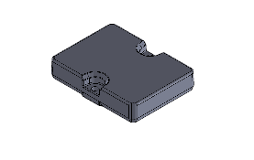

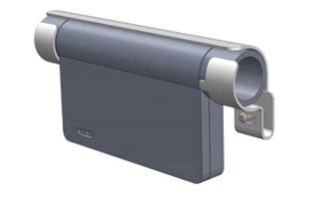
How Our Technology Works
Using Dot Ai, assets are digitized and tracked through the process as a complete, auditable Digital Thread. Valuable business insights are created, streamlining operations and enabling real-time optimization.
Asset Tag
ZIM Bridge
SaaS Cloud
BYOD
1
2
3
4
RF Beacons or Barcodes enable positive identification, sensing and tracking of key assets and material.
Mobile RF Readers and Cameras collect tag and sensor data in real-time, in-process.
Cloud Applications and the AI Engine guide workflows and enable asset intelligence.
Real Time Asset Inventory is viewed and actioned without the using proprietary devices.
25

Slide 26

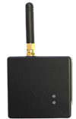
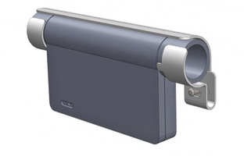

Unique Dot Ai Technology Advantages
An AI Engine and Cloud Applications
ZIM (Zero Infrastructure Mesh)
The only passive (battery free) 5G tags
17
Notes:
17

Slide 27

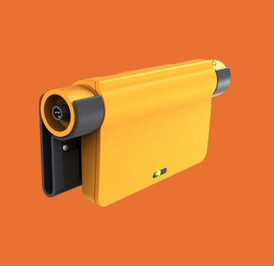
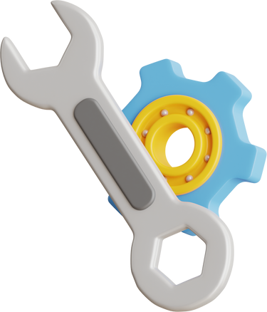
Product Component Roadmap
Q2
Q3
Q4
2025
  Support for Bridge
  Heatmap feature
  Rules Engine upgrade
  Workorder flow upgrade
  Machine Learning 1.0
  Gen2 RFID Reader
  Integrated cameras
  Machine Learning 1.1
  Bridge feature support
  Machine Learning 1.2
  Vision logic integration
  Bridge feature support
  Version 2.0
    Theming
    Recipes
    AI depth
  Korber/SAP Interfaces
Software
  Validate alternative active tags (project requirements)
  Pricer storelink testing
  Fanstel Gateway
  Industrial Passive Tag
  Manufacturing setup
  HW QA & Test
  Bridge Platform Launch
    MVP
    Marker SKUs
  Print Server (RPN)
  Bridge Platform
      Transit SKUs
      Access SKUs
  ZIM Mesh
  1.9 GHz platform
Hardware
  Channel Training v1
  WEC opening
  Partner Portal opens
    Pricebooks
    Collateral
  Channel Training v2
  EEC opening
  Ticketing system tested
    Knowledgebase
    SLA finalized
  Project mgmt service
  User Manual – Bridges
  User Manual – WPI
  UAT Test process
  Online Support system
  Global 24/7 support
    EEC/WEC, India
  UAT Regression Testing
    Automation
  Distribution Support
Services
27
Notes:
27

Slide 28
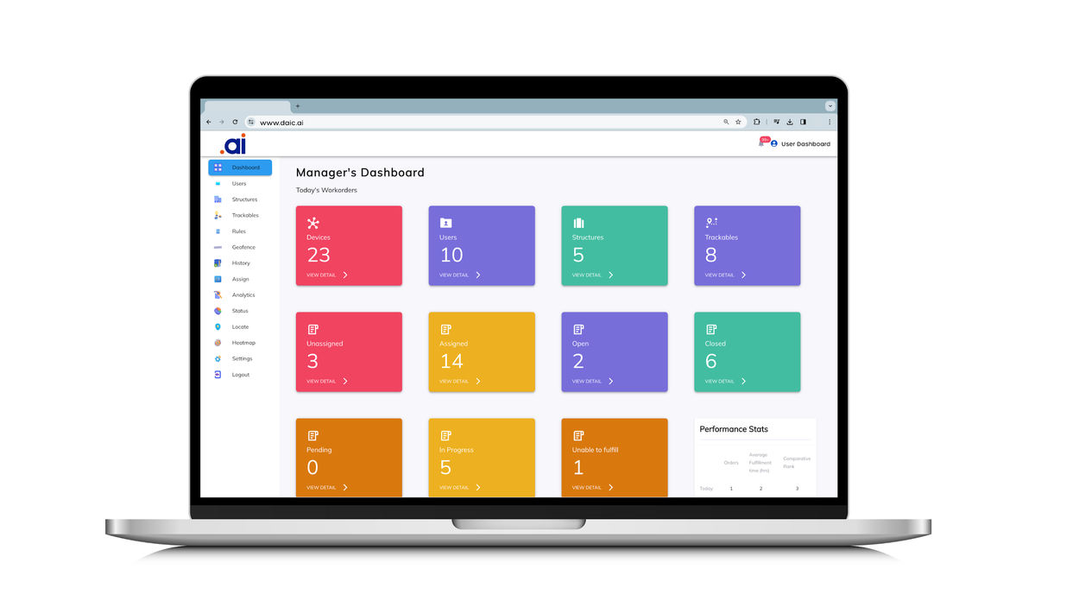

Dot Ai: A Logistics Platform Designed To Automate
Dot Ai leverages AI to deliver automated capabilities with revolutionary speed: eliminating excessive costs and operational friction for end customers
Dot Ai Advantages
  Automated Inventory, forecasting flow gaps, and escalation processes
  Real-time visibility of all assets in a centralized repository
  Automated customer notifications
  AI assisted scheduling, process and forecast management
  Optimized communication and safety workflows
  Full WMS/ERP-suite data validation
  Speedy 1-3 month implementation timeline
Automated Capabilities
Legacy Solutions
Implementation Speed
28
Notes:
(Ed Owns this Slide)

Slide 29
Go To Market
29
Notes:
(Charlie Owns this Slide)

Slide 30


Commercial Model Summary
Dot Ai works with Channel Partners to sell 1, 3, and 5 year subscriptions
Hybrid Contracts
Bundled SaaS Contracts
Global Account Management.
Software & Level 3 Support.
Bundling happens at the Channel level. Global Corporate Accounts will subscribe with global channel partners.
Subscription Solution Fees
End User
Subscription Solution Fees
Channel
Partner
Solution Delivery
$$
Solution Delivery
Channel
Partner
Install & Maintenance Fees
Premium Channel Partners are required to offer bundled SAAS contracts.
Hardware, installation, training. Hardware warranties and returns.
On-site and Level 2 Support.
30
Notes:
(Bob Owns this Slide)

Slide 31

Solution Maturity Model
IMMATURE
BASIC VISIBILITY
SUSTAINABLE VISIBILITY
MATURE VISIBILITY
MATURE MONITORING
MATURE CONTINUOUS AUTOMATION
Incomplete visibility of inventor
Manual paper processes dominate asset information
Real-time visibility of limited assets
Event rules for basic operations
Real-time visibility of all assets with automated tasks for dashboards
All internal inventory movement tracked
Limited Customer notifications
Safety notifications
Centralized Data repository
Real-time understanding of inventory flows
Optimized traffic
Optimized safety
Integrated with ERP/WMS
Automated Inventory rules
Automated Customer notifications of all changes
Cross functional ERP reporting
FULL WMS/ERP suite data validation
AI assisted task scheduling & process improvement
AI assisted optimized asset forecast management
1
2
3
4
5
6
Competitive Timeline for Implementation
Dot Ai
1-3 months with simple infrastructure deployment
COMPETITORS
1-3+ years with significant infrastructure costs
1-3 Months
1 Year
2 Years
3+ Years
31
Notes:
(Bob Owns this Slide)
Higher Focus Market- Target is 2196 customers sitting at “Immature” visibility.
31

Slide 32
Deal Desk: Sales Operations Reporting & Metrics
Channel Engagement
Customer Turnover Process
Owner: Marketing
Support: SDR/AM/SE
Owner: SDR
Support: AM
Owner: AM
Support: SDR/SE
Owner: AM
Support: SE
Owner: SE
Support: AM
Owner: AM
Support: SE/RD
Owner: AM
Support: SE/RD
Owner: AM
Support: SE/RD/CS
Owner: AM
Support: SE/RD
Pospect 10%
Assessment 20%
Engagement 40%
Evaluation 50%
Verbal Commit 70%
Contract Negotiation 80%
Closed Won 100%
Lead 5%
Closed Lost
Lead Gate:
1. Known, Valid Contact
2. Asset Management Identified Issues
Prospect Gate:
1. Confirmed meeting
2. BANT complete
3. Basic Technical Requirements
Assessment Gate:
1. Confirmed Sponsor (EB)
2. Core technical Requirements Achievable
3. Readiness Assessment
Engagement Gate:
1. Confirmed POV success criteria?
2. Confirmed EB meeting
OR
3. Confirmed reference Sale?
4. Confirmed process to approve close known
Evaluation Gate:
1. POV technical requirements signed off.
2. POV/BVA out-briefing with Economic Buyer
Verbal Commit Gate:
1. Executive sign-off
2. Purchase Process known and confirmed time for purchase
Contract Negotiation Gate:
1. Final Quote approved
2. SLA/License Agreement Complete
Closed Won:
1. Order Received
2. T&Cs approved
3. CS Team Introduced
4. Turnover Complete
Closed Lost:
1. CL Lost report complete
Marketing
Sales
Operations
32
Notes:
32

Slide 33
Deal Desk: Sales Operations Reporting & Metrics
Channel Engagement
Customer Turnover Process
Owner: Marketing
Support: SDR/AM/SE
Owner: SDR
Support: AM
Owner: AM
Support: SDR/SE
Owner: AM
Support: SE
Owner: SE
Support: AM
Owner: AM
Support: SE/RD
Owner: AM
Support: SE/RD
Owner: AM
Support: SE/RD/CS
Owner: AM
Support: SE/RD
Lead 5%
    Collection pre-qualification information to understand opportunity
Prospect 10%
    Further Validation of information and verification that there is a viable Dot Ai project
Assessment 20%
    Assess the value base don more meaningful Business and technical discussions
Engagement 40%
    Having a valid project and budget, continue relationship building and qualification. Finalize exit criteria to close opportunity.
Evaluation 50%
    Develop and execute a joint evaluation plan.
Verbal Commit 70%
    Prospect acknowledges they want to move forward with purchase. Has given verbal or written notification.
Contract Negotiation 80%
    Moving the customer through mutual partnership and product purchase with approval for execution and purchase order.
Closed Won 100%
    Purchase order executed. Turnover to PS and CS team
Closed Lost
    Reflection to learn and improve process, not moving forward with purchase
Lead Gate:
1. Known, Valid Contact
2. Asset Management Identified Issues
Prospect Gate:
1. Confirmed meeting
2. BANT complete
3. Basic Technical Requirements
Assessment Gate:
1. Confirmed Sponsor (EB)
2. Core technical Requirements Achievable
3. Readiness Assessment
Engagement Gate:
1. Confirmed POV success criteria?
2. Confirmed EB meeting
OR
3. Confirmed reference Sale?
4. Confirmed process to approve close known
Evaluation Gate:
1. POV technical requirements signed off.
2. POV/BVA out-briefing with Economic Buyer
Verbal Commit Gate:
1. Executive sign-off
2. Purchase Process known and confirmed time for purchase
Contract Negotiation Gate:
1. Final Quote approved
2. SLA/License Agreement Complete
Closed Won:
1. Order Received
2. T&Cs approved
3. CS Team Introduced
4. Turnover Complete
Closed Lost:
1. CL Lost report complete
Marketing
Sales
Operations
32
Notes:
32

Slide 34
Organizational Detail
33

Slide 35
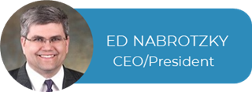


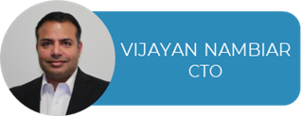

Dot Ai Management Team
EXPERIENCED | SUCCESSFUL
Ed Nabrotzky / CEO & President
Co-Founder and entrepreneur with 4 previous successful exits by merger. SME in IoT and AI with operational experience, published work and patents in these areas. Executive experience at public companies Molex and Panasonic.
Bob Reny / CRO
Entrepreneur with 3 previous successful exits, including an IPO. SME in Cybersecurity and AI with management experience and published work in the area. Executive experience at public company ForeScout. USAF veteran.
Bill Reny / CXO
Co-Founder, former USAF Crew Chief on F15 fighter aircraft. Master mechanic and author of more than a dozen books and manuals on automotive repair and maintenance. Patented inventor and passionate customer advocate.
Vijayan Nambiar / CTO
Executive experience at public companies leading R&D. SME in 5G systems and enterprise software. Led the team at Verizon for new 5G router platform. Strong history of recruiting and retaining dev talent, especially in India.
Charles Maddox / CFO
Co-Founder and entrepreneur with experience founding and leading several enterprises. SME in government contracting and fundraising. Raised more than $7M in seed for Dot Ai. USAF veteran pilot and drone operator.
34
Notes:
34

Slide 36
Dot Ai 2025 proposed organization structure.
Non US based
Existent team
New team
CEO
(President)
CRO
CMO
CXO
CTO
CFO
(Treasurer)
COO
Sales
Sales Ops
Marketing
PSG
Support
Research
Development
Finance
Operations
CDR - Channel
Brand/Promo
2
1
DevOps
Accounting & Finance
IT/Cyber
6
1
4
2
2
3
Support Representatives
RF & Protocol
(PR)
RSMs
Americas
2
Embedded
& DFM
Supply Chain & Purchasing
2
2
Content
Manufacturing Puerto Rico
1
+6
1
2
4
2
60
FAE
Chip Design
1
1
2
RSMs
Europe
2
1
3
Events & Campaigns
1
AI
1
3
2
2
RSMs
APAC
Application Test Engineer
AI
Admin
2
1
1
Frontend
7
4
EAM
2
HR
1
Cloud
Operations
1
2
Backend
1
1
ESE
4
4
2
Training/Docs
Counsel
Risk/Compliance
(Secretary)
4
2
QA
Sales Engineer
2
4
4
Strategy
(W, IoT, AI)
4
3
ISR/SDR
2
40
48
93
Admin
(Chief of Staff)
1
Sales Analyst
1

Slide 37


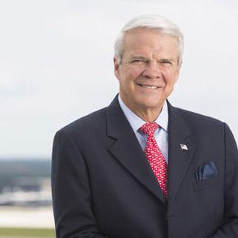


Key Advisors
Rob Novotny
USAF Brig Gen (retired), career fighter pilot and combat commander.
Former commander of the Wing that included the Thunderbirds, current executive at Boeing Corporation.
Allan McArtor
Former Chairman of Airbus North America.
Senior management leadership at FEDEX and served two years as Federal Administrator of the FAA.
Former USAF fighter pilot in Vietnam.
Tony Fuller
Advising Dot Ai after a 30 year career with Walmart.
Mr. Fuller has been privileged to work with, and provide counsel to the last five CEOs of the Walmart.
He is an expert in logistics systems.
Robert Heggie
Internationally recognized SME in non- traditional retail.
Consulted for many Fortune 500 companies, ex. Walmart, Target etc.
Marketing expert in multi-channels distribution
36

Slide 38



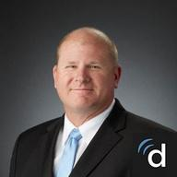


Proposed Director Backgrounds
A small board with big expertise is targeted, able to help scale our business,
open doors & provide the needed enterprise oversight
Jeff Saling / Chairman & Nominating Chair Proposed
A successful entrepreneur with 3 IPOs and 1 acquisition exit to his credit, Jeff is a founding member and Vice Chair on the NV Governor's Council on Startups. He leads the Sierra Angels and Startup NV seed investment groups. He has over 30 years of experience in launching, scaling, and exiting startups in the SaaS and cloud domains.
Holly Grey / Audit Chair Proposed
Currently serving as Chief Financial Officer at Exabeam, former SVP and VP of Finance at Forescout, Accuray and Aspect Software. Deep experience in accounting SAAS business models and reporting public market accounting. Accounting education and designations.
Joanna Burkey / Cyber Chair Proposed
CISO at HP and director on several Boards of technology companies, Joanna brings decades of experience in corporate governance and cyber issues. She is a published thought leader as well as a talented, respected leader in inspiring high-performance teams and promoting diversity in technology and cyber security.
Sheldon Paul / Member Proposed
Renowned medical practitioner and entrepreneur in Las Vegas, Dr. Paul has developed and operated multiple clinics across the west coast over 28 years of practice. He has also branched into other businesses and investments very successfully, including early investments in Dot Ai. He brings unique practical entrepreneurial experience.
Dr. David Carlson / Governance & Compensation Chair Proposed
David Carlson, DO, MBA is the Chief Medical Officer in South King County for Virginia Mason Franciscan Health. Dr. Carlson is a member and former chair of Physician Insurance Company, and has served on the boards of the Washington Healthcare Alliance, United Way Pierce County and Physicians of Southwest Washington.
Phyllis Newhouse / Member Proposed
Serial entrepreneur and investor, retired military senior officer and mentor. She is CEO and Founder of ShoulderUp Technology Acquisition Corp, Founder and CEO of Xtreme Solutions, Inc. A pioneer in business, she is the first woman to win an Ernst & Young (EY) Entrepreneur Of The Year® award in the technology category.
37

Slide 39


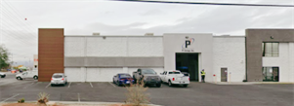

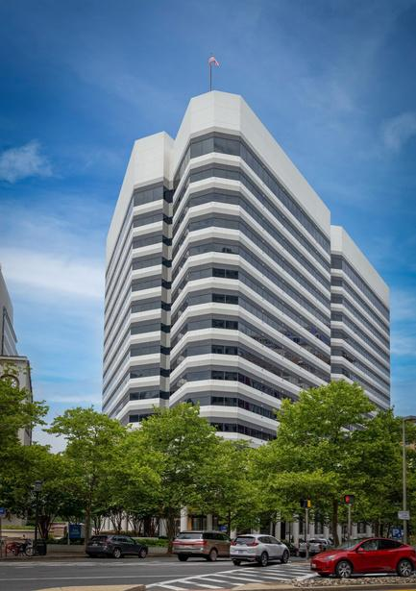
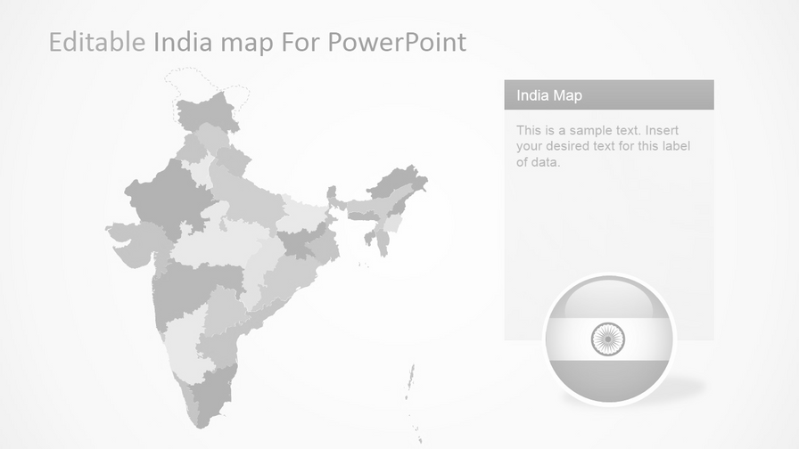

Locations
Customer Success staff across the country and in India for 24/7 support coverage
Systems Lab, Shirley, MA
  Protocol/Firmware Dev & Test
  DFM/Certs Engineering
  Technical Meetings & Demos
Corporate HQ, Western Experience Center, Las Vegas, NV
Admin Center
Eastern Experience Center
Bethesda, MD
Software Team in Bangalore, India
(Lab & Subsidiary planned in 2025)
A Dot Ai Company
Manufacturing & Test, Puerto Rico
38
Notes:
(Charlie Owns this Slide)

Slide 40
Appendix
43

Slide 41
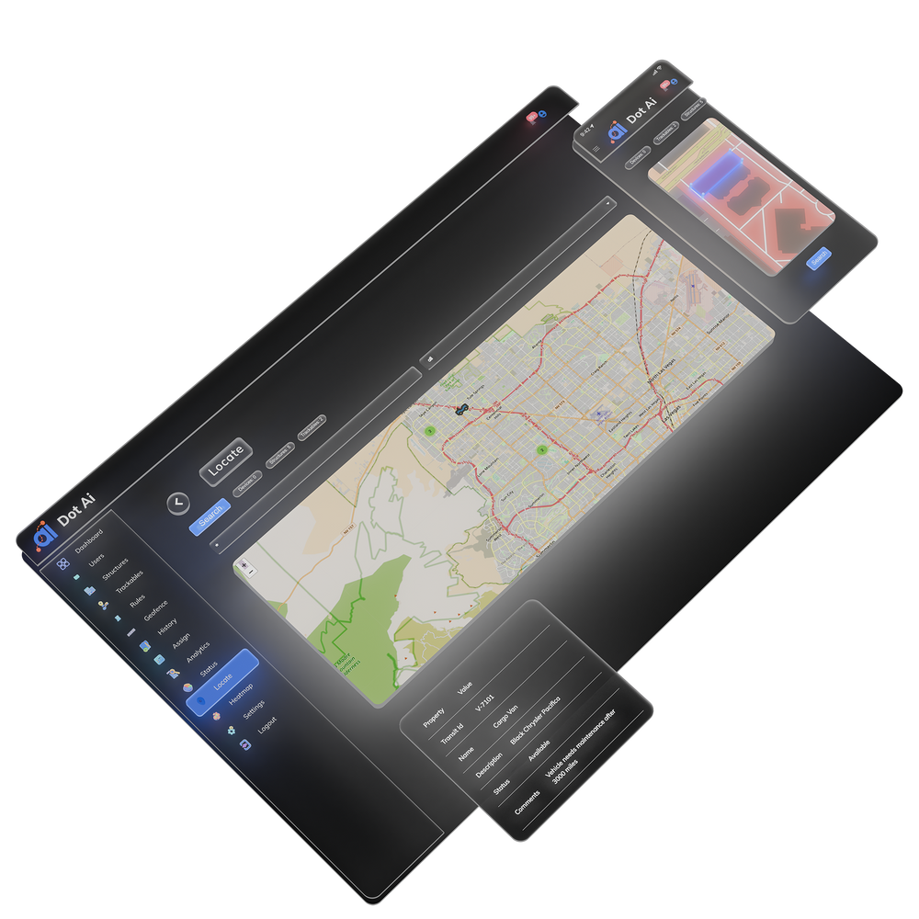
AI Engine and Cloud Applications – Software Teams
Embedded Team:
  ZIM Bridge Firmware
  Manufacturing & Test Program
Back End Team:
  ZIM Bridge Support
  UHF RFID reader support
  AI Camera Integration
  Cost reductions on AWS
Front End Team:
  UI/UX improvements
  Image handling
  Mobile App (PWA)
AI Team:
  Image interpretation
  Machine learning module
Dev Ops & Test:
  Tools and support of development operations
SOC2
Cyber Audits & Compliance improvements
45

Slide 42








Message Query Telemetry Transport (MQTT)
Businesses Across Supply Chain & Logistics Face Consistent Challenges
MQTT Client
Gateway
(RF or LAN)
MQTT Broker
MQTT Client Subscriber
Publish
MQTT Client Subscriber: Mobile Device
Location
Publish
Publish
Publish
MQTT Client Subscriber: Backend
System
Location, video move, temp
44

Slide 43
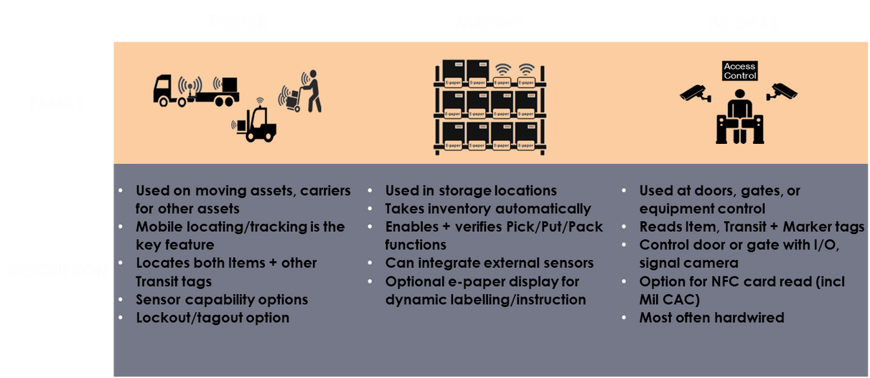
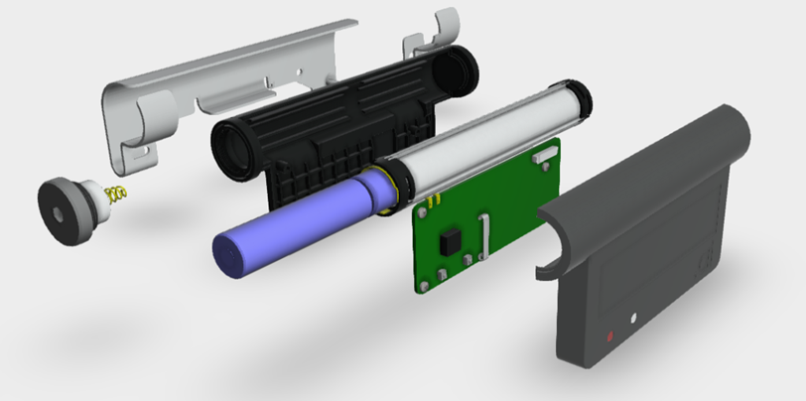
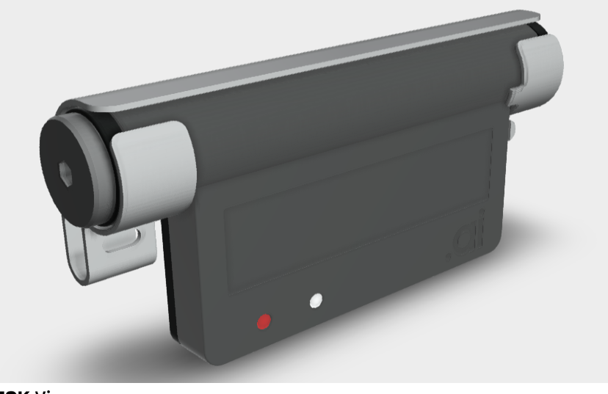
Our ZIM Bridge Platform
The only industrial grade, battery-powered, passive BLE reader platform
3 Families
52 SKUs
Transit Marker Access
Features:
  Energizes passive tags @ UHF
  Reads beacons @ Microwave (BLE)
  Collects and forwards data (out to 15 km)
  Supports LoRA, BLE and GNSS
  Enables many optional wired peripherals
  Takes common commercial batteries
  On/Off switch option (tail cap)
Key build options include:
          High visibility LEDs
          M12 wiring connector option
          Tamper evident sensing
          NFC coil option
The only battery-powered passive IoT data collector (patent pending)
ZIM Bridge is approximately
6” x 3” x 1.25”
46

Slide 44

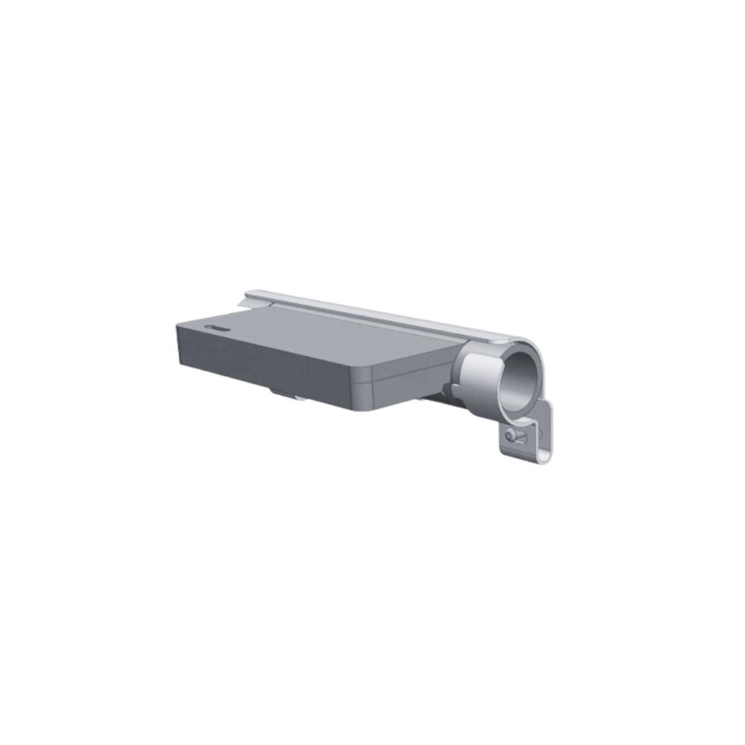
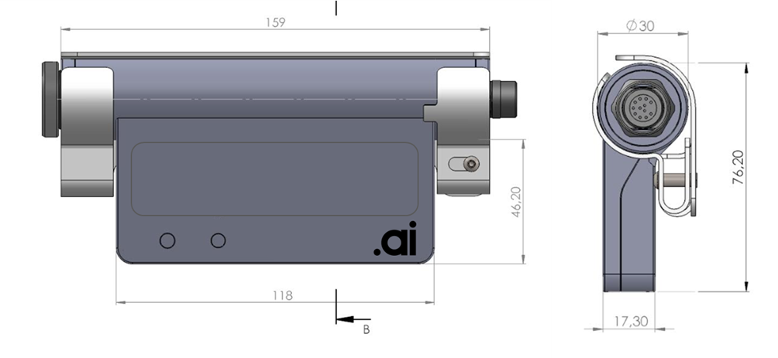
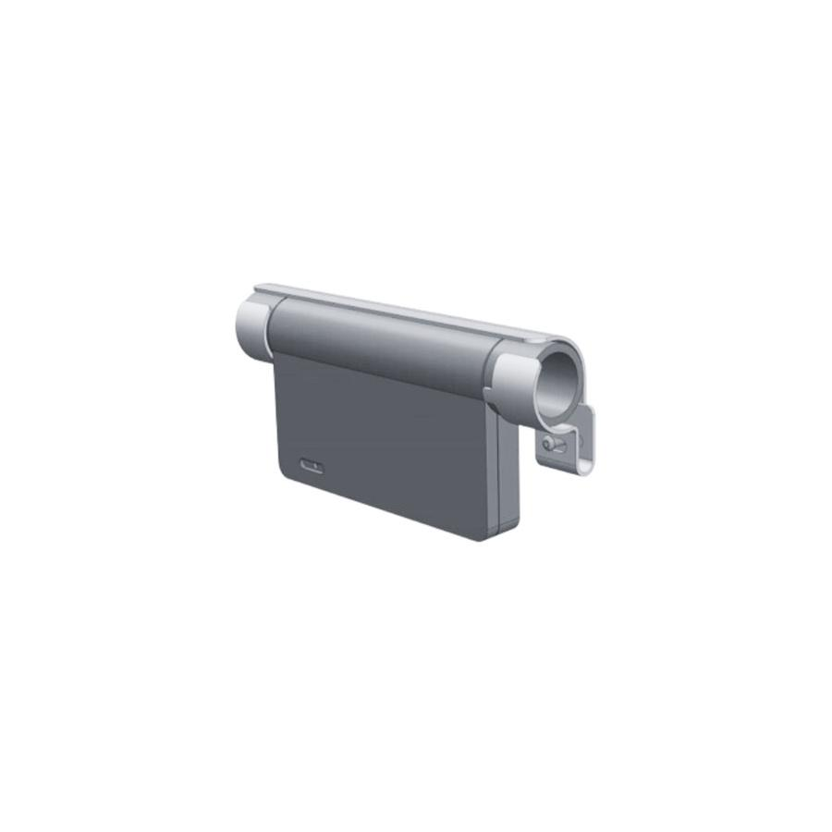
ZIM Bridges
Transit
Access
  Used on moving assets, carriers for other assets
  Mobile locating/tracking is the key feature
  Locates both Items + other Transit tags
  Sensor capability options
  Lockout/tagout option
  Used at doors, gates, or equipment control
  Reads Item, Transit & Marker tags
  Control door or gate with I/O, signal camera
  Option for NFC card read (incl Mil CAC)
  Most often hardwired
Marker
  Used in storage locations
  Takes inventory automatically
  Enables + verifies Pick/Put/Pack functions
  Can integrate external sensors
  Optional e-paper display for dynamic labelling/instruction
47

Slide 45

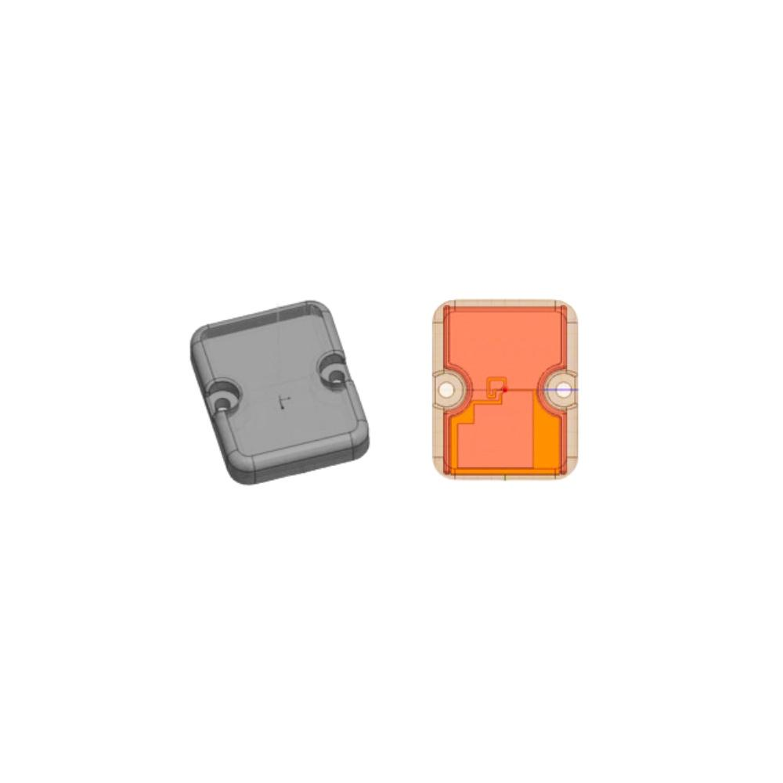
Our Industrial Tag
Wiliot labels are our primary item tag
  Consumable use case
  Does not work on-metal
  Detuned by liquids (including rain or snow)
          Requires new RF inlay
  Wrapped around a plasmonic core
  Encased in a tough cover
Target Market needs a tag that works on-metal and outdoors in harsh environments
48

Slide 46
RF Hardware Range & Visibility
Theoretical 2000 tags per bridge
Practical 500 tags per bridge
Passive BLE Tags
10 – 15 m read range
6 m practical
RTLS = 400 sq ft
2 m accuracy
Inventory = 1,600 sq ft
to nearest bridge
Practical Offset Range
20’ (passive) or 200’ (active)
Active BLE Tags
75 – 100 m read range
60 m practical
RTLS = 40,000 sq ft
2 m accuracy
Inventory = 160,000 sq ft
to nearest bridge
RTLS Bridge
Inventory Bridge
49
Notes:
49

Slide 47



Cyber Security
Services we leverage:
Penetration Testing
User Authentication
Mechanisms we have implemented:
CSRF - Cross-site request forgery (also known as CSRF or XSRF) a malicious exploit of a website where unauthorized commands are transmitted from a user that the web application trusts.
Rate Limiting - technique to protect applications from brute-force attacks
Express Mongo Sanitize - a package that provides middleware to sanitize user input before it is used in a database query. It is designed specifically to prevent NoSQL injection attacks in Node. js applications that use MongoDB
AWS Systems Manager Parameter Store - provides secure, hierarchical storage for configuration data management and secrets management.
Helmet - protects app from some well-known web vulnerabilities by setting HTTP headers appropriately
CORS (Cross-origin resource sharing) - a mechanism that allows resources to be securely requested from another domain
50
Notes:
50

Slide 48
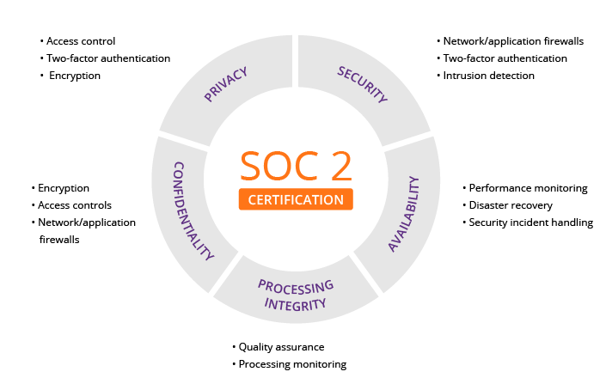
Cyber Security
Certifications in progress:
2024 Q4 (Commercial Standard)
  SOC2 Type 2
2025 (Mil/Gov contracts)
  FAR 52.204-21
  NIST SP 800-171r2
  CMMC 2.0 Level 1
Note that AES 128 Private Key Encryption is already implemented natively on all ZIM wireless networks
51
Notes:
51

Slide 49












Differentiated From the Landscape
Innovative Approach
  Established incumbents and competitors attempt to apply legacy IoT tech through highly restrictive transactional business models.
  Dot Ai brings modern, AI-driven tech to a fragmented market through a SaaS business model.
  Dot Ai’s key differentiators:
    Invests heavily in AI development
    Simplifies complex buying decisions
    Leverages device-agnostic software
    Enhances accuracy & reliability of location data
    Dramatically lowers TCO (total cost of ownership) over time
Legacy Tech
Innovative Tech
Market Leader with legacy hardware culture and a vulnerable channel to exploit
Market Leader with good tech but Direct Sale model alienates channel players looking for next gen
Legacy Business Model
52
52
Notes:
(Bob Owns this Slide)

